Slide 1

Slurm Infosession
https://github.com/hpcleuven/wice-inauguration

Slide 2

Why
We want to have a uniform user experience -> all VSC sites are/will be using Slurm.
Recently developing faster than Torque.
Slurm is free and open-source, available under the GNU General Public License v2, there is a possibility for commercial support.
Allowing extra features (for experienced users).

Slide 3
Slurm
The Slurm Workload Manager, formerly known as Simple Linux Utility for Resource Management (SLURM).
As of November 2021, according to the TOP500 list of most powerful computers, Slurm is the workload manager on more than half of the top ten systems.
Slurm's design is very modular with ~100 optional plugins used for sophisticated configurations:
database integration for accounting,
management of resource limits
and workload prioritization.

Slide 4

General overview – what can we request from Slurm
GPU Island
4 nodes
Thin node Island
172 nodes
Large memory Island
5 nodes
Interactive Island
No specific
login nodes
5 nodes

Slide 5
Jobsystem
Different workload manager: Slurm instead of Torque+Moab Job submission currently happens from Genius login nodes
Main commands
Job submission: sbatch and srun or salloc + ssh Job information: squeue, scontrol Cluster status: sinfo MAM-like tools: to be used from a wICE interactive node sam-balance sam-list-allocations sam-list-usagerecords sam-statement
Job options Slurm job options are different from Torque (see next slides) #SBATCH jobscript directives instead of #PBS Suggested jobscript name extension: *.slurm

Slide 6
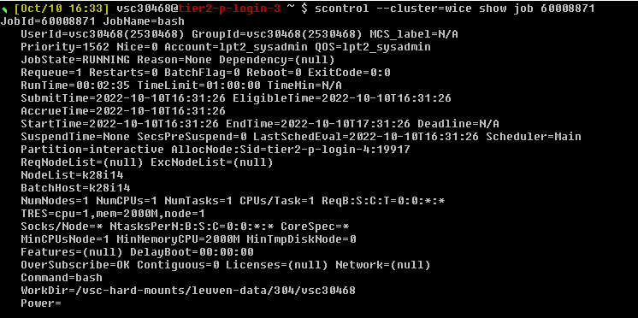
Jobsystem

Slide 7
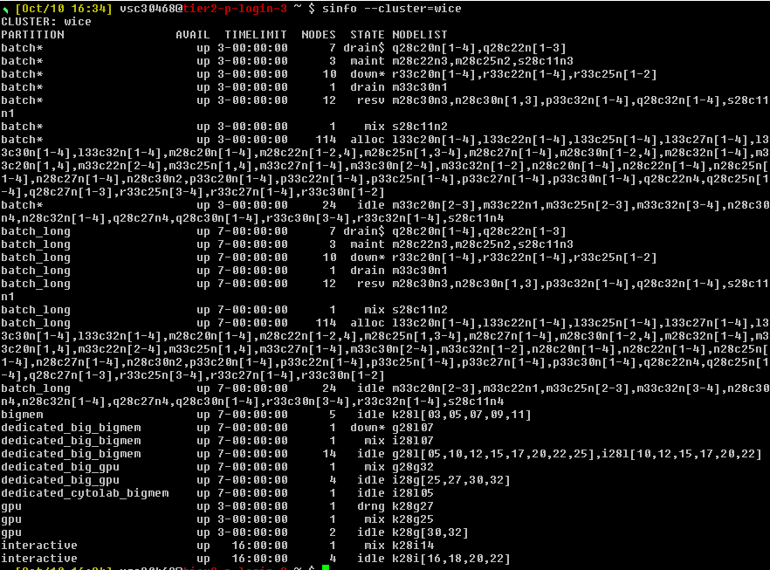
Jobsystem

Slide 8


Jobsystem

Slide 9
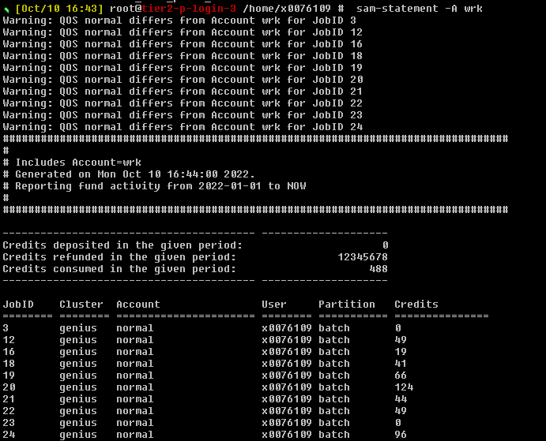
Jobsystem
Not everyone within the project can see it

Slide 10
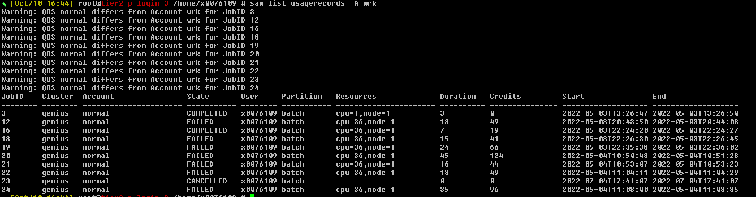
Jobsystem
Not everyone within the project can see it

Slide 11
Jobs: Torque to Slurm conversion
Torque | SLURM | Action
qsub job.pbs | sbatch --cluster=wice job.slurm | Submit a job with batch script
qsub [resources] -I | srun [resources] --cluster=wice --pty bash -l | Start an interactive job
qdel <JOB_ID> | scancel --cluster=wice <JOB_ID> | Delete a job
qstat | squeue --cluster=wice --states=all | Show job queue status
qstat -f <JOB_ID> | scontrol show job <JOB_ID> --cluster=wice | Show details about a job
pbsnodes | sinfo --cluster=wice | View information about nodes and partitions.
showstart <job_id> | squeue --cluster=wice -j <job_id> --start | Get estimated start time of job

Slide 12
Jobs: Torque to Slurm conversion
Torque | SLURM
-l nodes=X:ppn=Y | --nodes=X --ntasks-per-node=Y or --ntasks=X*Y or --ntasks=X –-cpus-per-task=Y (hybrid MPI/OpenMP only) Default: single-core job
-l partition=gpu | --partition=gpu Default: "batch" partition)
-l pmem=Xgb | --mem-per-cpu=XG Default: average memory/core
-l walltime=hh:mm:ss | --time=hh:mm:ss Default: max walltime for partition
-N jobname | -J jobname
-o file | -o file_template
-e file | -e file_template Default: same as stdout
-m abe | --mail-type=FAIL,BEGIN,END
-M <mailaddress> | --mail-user=<mailaddress>
-v key=value | --export=ALL,key=value Additional variables to pass to job

Slide 13
Jobs: Torque to Slurm conversion
Torque | SLURM
PBS_JOBNAME | SLURM_JOB_NAME %j in filename templates
PBS_JOBID | SLURM_JOB_ID
PBS_NODEFILE | Replaced by a variable specifying the nodes rather than a node file: SLURM_JOB_NODELIST
PBS_NUM_NODES | SLURM_JOB_NUM_NODES
PBS_NUM_PPN | SLURM_JOB_CPUS_PER_NODE
PBS_NP | SLURM_JOB_NUM_NODES * SLURM_JOB_CPUS_PER_NODE or SLURM_NTASKS * SLURM_CPUS_PER_TASK
PBS_O_WORKDIR | SLURM_SUBMIT_DIR
PBS_ARRAYID | SLURM_ARRAY_TASK_ID

Slide 14
How to start
For beginners we have a tool pbs2slurm
It can translate directives of the pbs script and display on the screen
MAM accounts will not allow the tool to start translating, you need to provide a valid Slurm account (in pbs script)
It does not understand partition concept
May create conflicts if your own conda is active
(in PYTHONPATH, uses python3)
$ more test.pbs
#!/bin/bash
#PBS -A lpt2_sysadmin
#PBS -l nodes=2:ppn=36
#PBS -l walltime=6:30:00
#PBS -N my_job
#PBS -M mag.selwa@kuleuven.be
#PBS -m ae
cd $PBS_O_WORKDIR
module purge
module load foss/2018a
mpirun hello.exe

Slide 15
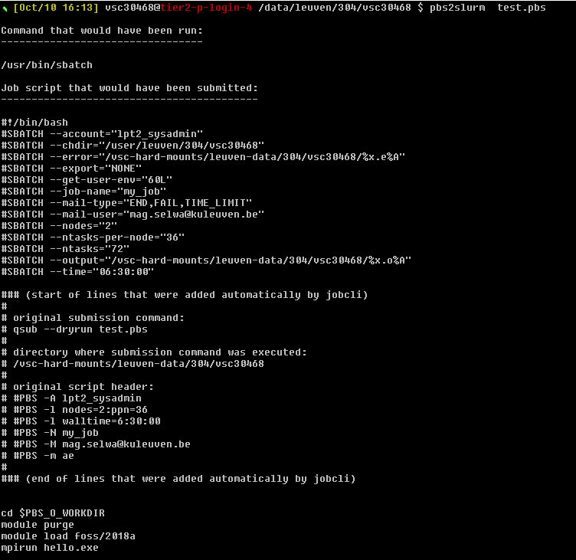
$ pbs2slurm test.pbs
Command that would have been run:
---------------------------------
/usr/bin/sbatch
Job script that would have been
submitted:
------------------------------------------

Slide 16
#!/bin/bash
#SBATCH --account="lpt2_sysadmin"
#SBATCH --chdir="/user/leuven/304/vsc30468"
#SBATCH --error="/vsc-hard-mounts/leuven-data/304/vsc30468/%x.e%A"
#SBATCH --export="NONE"
#SBATCH --get-user-env="60L"
#SBATCH --job-name="my_job"
#SBATCH --mail-type="END,FAIL,TIME_LIMIT"
#SBATCH --mail-user="mag.selwa@kuleuven.be"
#SBATCH --nodes="2"
#SBATCH --ntasks-per-node="36"
#SBATCH --ntasks="72"
#SBATCH --output="/vsc-hard-mounts/leuven-data/304/vsc30468/%x.o%A"
#SBATCH --time="06:30:00"

Slide 17
### (start of lines that were added automatically by jobcli)
#
# original submission command:
# qsub --dryrun test.pbs
#
# directory where submission command was executed:
# /vsc-hard-mounts/leuven-data/304/vsc30468
#
# original script header:
# #PBS -A lpt2_sysadmin
# #PBS -l nodes=2:ppn=36
# #PBS -l walltime=6:30:00
# #PBS -N my_job
# #PBS -M mag.selwa@kuleuven.be
# #PBS -m ae
#
### (end of lines that were added automatically by jobcli)

Slide 18
cd $PBS_O_WORKDIR
module purge
module load foss/2018a
mpirun hello.exe

Slide 19
Jobs: additional Slurm-Torque differences
Slurm starts the job in the directory it was submitted from (Torque: in $HOME).
Slurm partitions are
a combination of Torque partitions and Torque queues.
Regular Slurm partitions on wICE have a maximum walltime of 3 days.
For up to 7-day jobs on the thin nodes, specify --partition=batch_long
there are currently no bigmem_long or gpu_long partitions (3 days job max).
Currently, your environment variables at job submission are exported to the Slurm job (Torque: always a clean environment). For a reliable clean start, we recommend to:
deactivate any Conda environments before submitting
executing module --force purge before submitting (or adding this line to the beginning of your jobscripts)
More information on this topic can be found here.

Slide 20
Jobs: bigmem example
PBS (on Genius)
Torque (on Genius)
Slurm (on wICE)
~$ qsub -N MyBatchJob
-l nodes=4:ppn=36,walltime=00:15:00,
feature=skylake:singleisland,partition=bigmem,pmem=20gb -A lp_pilot job.pbs
~$ sbatch –-cluster=wice -J MyBatchJob
--time=00:15:00
--nodes=2 --ntasks-per-node=72
--constraint=icelake --switches=1
--partition=bigmem --mem-per-cpu=20G
--account=lp_pilot job.slurm
or in a short format:
~$ sbatch –-cluster=wice -J MyBatchJob
-t 00:15:00 -N 2 --ntasks-per-node=72
-C icelake --switches=1 -p bigmem
--mem-per-cpu=20G -A lp_pilot job.slurm

Slide 21
Jobs: thin node example (batch script)
PBS (on Genius)
Torque (on Genius)
Slurm (on wICE)
#!/bin/bash
#PBS -N hello_world
#PBS -l nodes=2:ppn=36
#PBS -l walltime=160:00:00
#PBS -l pmem=5gb
#PBS –A lp_pilot
#PBS -j oe
#PBS -o $PBS_JOBNAME-$PBS_JOBID.log
cd $PBS_O_WORKDIR module load intel/2018a
mpirun hello_world
#!/bin/bash
#SBATCH --cluster=wice
#SBATCH --job-name="hello_world"
#SBATCH -N 1
#SBATCH --ntasks-per-node=72
#SBATCH -t 6-16:00:00
#SBATCH –p batch_long
#SBATCH --mem-per-cpu=3400M
#SBATCH –A lp_pilot
#SBATCH --output=%x-%j.log
cd $SLURM_SUBMIT_DIR # usually not needed module --force purge
module use /apps/leuven/icelake/2021a/modules/all
module load intel/2021a mpirun hello_world

Slide 22
Jobs: GPU example
PBS (on Genius)
Torque (on Genius)
Slurm (on wICE)
~$ qsub -N MyGPUJob
-A lp_pilot
-l nodes=1:ppn=18:gpus=2,partition=gpu job.pbs
~$ sbatch --cluster=wice -J MyGPUJob
-A lp_pilot -N 1 --ntasks=36 --gpus-per-node=2 -p gpu job.slurm

Slide 23
Jobs: job array example
PBS (on Genius)
Slurm job arrays allow to set up and manage series of similar jobs. For an array of 72 single-core calculations (which will normally end up running on the same node): #!/bin/bash #SBATCH -n 1 ... #SBATCH --array=1-72 Each array element will have a task ID given by ${SLURM_ARRAY_TASK_ID} The total number of tasks (here: 72) will be given by ${SLURM_ARRAY_TASK_COUNT} Default output file names will be formatted as slurm-<jobID>_<1-…>.out
Note: worker and atools are not fully available on wICE

Slide 24
Jobs: interactive job example
For interactive pre- and post-processing work, submit to the "interactive" partition. For e.g. a short interactive single-core session: srun -n 1 -t 01:00:00 -A lt2_wice_pilot_xx --partition=interactive --cluster=wice --pty bash –l
To enable X-forwarding, add the --X11 option To also request one GPU instance, add the --gpus=1 option
To submit the job from interactive node you can use sbatch command.
But for further tests with srun you need to first request resources:
$ salloc --cluster=wice -A lp_pilot_xx -n 1 -t 30:00
And only then run
$ srun --pty /bin/bash –l
Alternatively, instead of srun, it is possible to ssh to the reserved node.

Slide 25
Jobs: Defaults
PBS (on Genius)
If no explicit resources are given your job will start
with 1 node 1 core,
with walltime of 3 days
in batch partition
jobs with no cluster given may start on Genius cluster (and get job-id ~760)
soon the slurm accounts will be available also on Genius (with the same account name)

Slide 26
Jobs: Tips and Tricks
PBS (on Genius)
job id on wICE is ~60008890
scancel command does not give any feedback – please check with squeue if ok
do not copy-paste the commands, slurm is sensitive not only to – but also spaces that look normal, but have a different encoding. You can check the command with cat –tve -

Slide 27
Jobs: advanced MPI launch commands
PBS (on Genius)
In some cases (e.g. hybrid MPI/OpenMP applications), you may be interested in closer control of MPI process pinning. Here are some options to consider: * Intel MPI in intel/2021a:
export HOSTS=$(scontrol show hostnames $SLURM_JOB_NODELIST | paste -s -d,) export OMP_NUM_THREADS=2 export I_MPI_DEBUG=4 export I_MPI_PIN_RESPECT_CPUSET=off export I_MPI_PIN_DOMAIN=omp export OMP_PROC_BIND=true mpirun -np 36 -hosts $HOSTS -perhost 36 … * Open MPI in foss/2021a:
export OMP_NUM_THREADS=2 export OMP_PROC_BIND=true mpirun -np 36 --report-bindings --map-by ppr:36:node:pe=2 …
* Also Slurm's own srun MPI launcher can be used. For Intel MPI compiled applications together with srun, consult the Intel documentation.

Slide 28
Jobs: status codes
The squeue --cluster=wice command will display one of the following status codes for a job:
CD COMPLETED Job has terminated all processes on all nodes with an exit code of zero.
CA CANCELLED Job was explicitly cancelled by the user or system admin. The job may or may not have been initiated.
CF CONFIGURING Job has been allocated resources, but are waiting for them to become ready for use (e.g. booting).
CG COMPLETING Job is in the process of completing. Some processes on some nodes may still be active.
F FAILED Job terminated with non-zero exit code or other failure condition.
NF NODE_FAIL Job terminated due to failure of one or more allocated nodes.
OOM OUT_OF_MEMORY Job experienced out of memory error.
PD PENDING Job is awaiting resource allocation.
R RUNNING Job currently has an allocation.
ST STOPPED Job has an allocation, but execution has been stopped with SIGSTOP signal. CPUS have been retained by this job.
S SUSPENDED Job has an allocation, but execution has been suspended and CPUs have been released for other jobs.
TO TIMEOUT Job terminated upon reaching its time limit.

Slide 29
Jobs: credits
Credits You need access to Slurm compute credits Genius credit accounts will not work Transferring credits between clusters and accounts is possible (can be requested). Use sam-balance (on a wICE interactive node )to see your available Slurm credits: Select the account in your jobs using the –A/--account option
~$ sam-balance ID Name Balance Reserved Available ======== ====================== =============== =============== =============== 123 lt2_wice_pilot_xx 100000 0 100000

Slide 30
Jobs: credits
1000 Slurm credits are equivalent to 1 MAM credit. The reason is that Slurm credit accounting happens in integer format.
Billing rates can be obtained as follows:
Computing for 1 minute on a single GPU node will be billed as: ngpus*258.33 + ncores*4.16667 credits
~$ scontrol show partitions --cluster=wice … PartitionName=gpu … TRESBillingWeights=CPU=4.16667,GRES/gpu:a100-sxm4-80gb=258.33333

Slide 31
Current problems:
No specific wICE login nodes -> looking or the software on interactive job displays also Genius modules (SLURM exports env variables)

Slide 32
Submitting worker jobs
Can be done from Genius or from interactive node on wICE
$ module av worker
-------------------------- /apps/leuven/icelake/2021a/modules/all -------------
worker/1.6.12-foss-2021a worker/1.6.12-intel-2021a (D)
-------------------------- /apps/leuven/skylake/2021a/modules/all -------------
worker/1.6.12-foss-2021a-slurm worker/1.6.12-intel-2021a-slurm
worker/1.6.12-foss-2021a-wice worker/1.6.12-intel-2021a-wice
worker/1.6.12-foss-2021a worker/1.6.12-intel-2021a (D)

Slide 33
Submitting worker jobs
Let us use one of the worker examples: https://github.com/gjbex/worker/tree/master/examples
alp.slurm alpha.csv
#!/bin/bash -l
#SBATCH --nodes=1
#SBATCH --ntasks-per-node 27
#SBATCH --time=00:30:00
#SBATCH -A lpt2_sysadmin
#SBATCH --cluster=wice
cd $SLURM_SUBMIT_DIR
alphabet.sh $letter $counter
letter,counter
a,1
b,2
c,3
d,4
e,5
f,6
....

Slide 34

Submitting worker jobs
From Genius
#!/bin/bash -l
module purge
module use /apps/leuven/skylake/2021a/modules/all
module load worker/1.6.12-intel-2021a-wice
wsub -batch alp.slurm -data alpha.csv

Slide 35
Submitting worker jobs
From interactive job on wICE
#!/bin/bash -l
module purge
module use /apps/leuven/icelake/2021a/modules/all
module load worker/1.6.12-intel-2021a
wsub -batch alp.slurm -data alpha.csv

Slide 36
Extra features
https://github.com/gjbex/slurm_examples
It is possible to run multiple applications in parallel in the same job (Multiple Process, Multiple Data).
#!/usr/bin/env bash
#SBATCH -A lpt2_sysadmin
#SBATCH --nodes=1 --ntasks=1 --cpus-per-task=16
#SBATCH --time=00:05:00
module --force purge
module use /apps/leuven/icelake/2021a/modules/all
module load foss
srun --exclusive --cpus-per-task=4 mem_limit/mem_limit_no_mpi -t 4 -m 3gb -i 500mb -s 20ms > task-1.txt &
srun --exclusive --cpus-per-task=4 mem_limit/mem_limit_no_mpi -t 4 -m 2gb -i 200mb -s 200ms > task-2.txt &
srun --exclusive --cpus-per-task=8 mem_limit/mem_limit_no_mpi -t 8 -m 1gb -i 100mb -s 50ms > task-3.txt &
wait

Slide 37
https://github.com/gjbex/slurm_examples
running applications that each require specific resources
#!/usr/bin/env bash
#SBATCH -A lpt2_sysadmin
#SBATCH --nodes=1 --cpus-per-task=1
#SBATCH hetjob
#SBATCH --nodes=1 --ntasks=12 --cpus-per-task=6
#SBATCH --time=00:15:00
module unuse /apps/leuven/skylake/2018a/modules/all
module use /apps/leuven/icelake/2021a/modules/all
module load foss/2021a
srun --exclusive --nodes=1 --ntasks=1 --cpus-per-task=1 \
mem_limit/mem_limit_no_mpi -m 1gb -i 200mb -s 1s > output_0.txt &
export OMP_PROC_BIND=true
export OMP_PLACES=cores
for (( computation_id=1; computation_id <= $SLURM_NTASKS_HET_GROUP_1; computation_id++ ))
do
srun --exclusive --het-group=1 \
--ntasks=3 --nodes=1 --cpus-per-task=2 \
--threads-per-core=1 \
mpirun -n 3 mem_limit/mem_limit -t 2 -m 1gb -i 200mb -s 1s > "output_${computation_id}.txt" &
done
wait

Slide 38
https://github.com/gjbex/slurm_examples
Running a hybrid OpenMP/MPI application on multiple nodes with process/thread binding
#!/usr/bin/env bash
#SBATCH -A lpt2_sysadmin
#SBATCH --cluster=wice
#SBATCH --nodes=2 --ntasks=72 --cpus-per-task=2
#SBATCH --time=00:15:00
module unuse /apps/leuven/skylake/2018a/modules/all
module use /apps/leuven/icelake/2021a/modules/all
module load foss/2021a
export OMP_PROC_BIND=close
mpirun -x OMP_PROC_BIND=$OMP_PROC_BIND --cpus-per-proc 2 --bind-to core mem_limit/mem_limit -t 2 -m 2gb -i 100mb -s 500ms > multinode_output.txt

Slide 39
https://github.com/gjbex/slurm_examples
Running a non-hybrid MPI application (Intel MPI) with processes spread out to maximize memory bandwidth.
#!/usr/bin/env bash
#SBATCH -A lpt2_sysadmin
#SBATCH --nodes=1 --ntasks=16 --cpus-per-task=1
#SBATCH --time=00:05:00
module --force purge
module use /apps/leuven/icelake/2021a/modules/all
module load intel
export I_MPI_PIN=1
export I_MPI_PIN_DOMAIN=4
export I_MPI_JOB_RESPECT_PROCESS_PLACEMENT=disable
mpirun -np 4 mem_limit/mem_limit -m 3gb -i 500mb -s 2s -l 5s

Slide 40
https://github.com/gjbex/slurm_examples
Running a non-hybrid MPI application (Intel MPI) with processes spread out to maximize memory bandwidth (alternative approach).
#!/usr/bin/env bash
#SBATCH -A lpt2_sysadmin
#SBATCH --nodes=1 --ntasks=16 --cpus-per-task=4
#SBATCH --time=00:05:00
module --force purge
module use /apps/leuven/icelake/2021a/modules/all
module load intel
export I_MPI_PIN=1
export I_MPI_JOB_RESPECT_PROCESS_PLACEMENT=disable
mpirun -np 4 mem_limit/mem_limit -m 3gb -i 500mb -s 2s -l 5s

Slide 41
More information about Slurm
https://slurm.schedmd.com/
https://docs.vscentrum.be/en/latest/antwerp/SLURM_UAntwerp.html#antwerp-slurm
https://docs.vscentrum.be/en/latest/antwerp/SLURM_convert_from_PBS.html?highlight=slurm
https://www.marquette.edu/high-performance-computing/pbs-to-slurm.php#:~:text=In%20PBS%2C%20you%20ask%20for,evenly%20distributed%20across%20N%20nodes.
https://oit.utk.edu/hpsc/isaac-open-enclave-new-kpb/isaac-open-enclave-slurm/
https://www.msi.umn.edu/slurm/pbs-conversion
https://userinfo.surfsara.nl/documentation/translate-pbstorque-slurm
https://www.serc.iisc.ac.in/serc_web/wp-content/uploads/2019/05/SLURM.pdf

